Slide 1
Purchase Requisition:
A purchase requisition is the first step in a procurement process. A purchase requisition is a request to purchase items. A requisition can consist of multiple line items.

Slide 2
Creating Purchase Requisitions in SAP

Slide 3
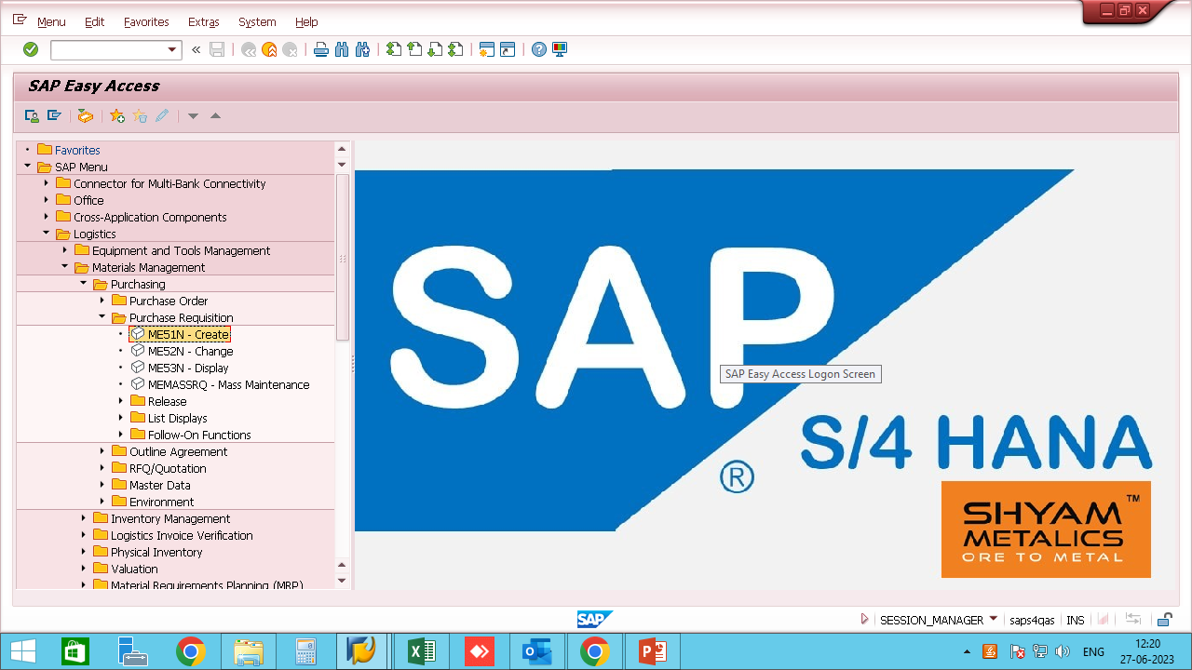
Purchase Requisition can be created by following below steps:
Path to create purchase requisition:
  Logistics → Materials Management → Purchasing → Purchase Requisition → Create (T-Code: ME51N)

Slide 4
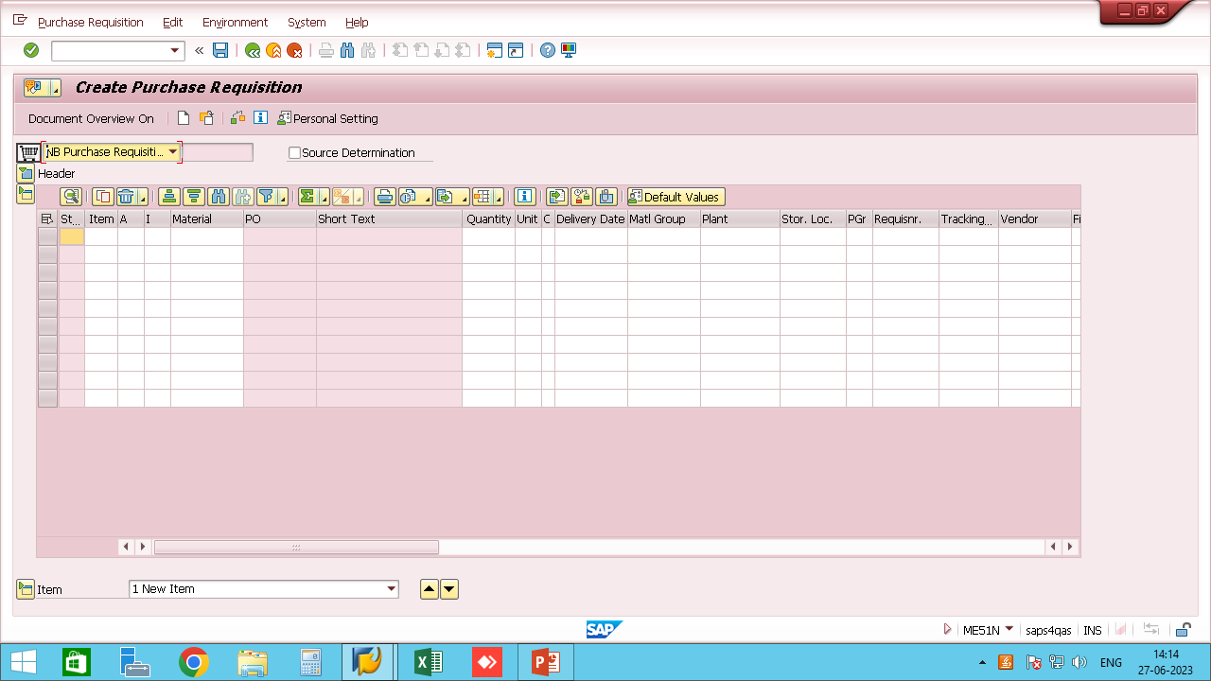
After Executing the T-Code the Create Purchase Requisition screen will open as below

Slide 5
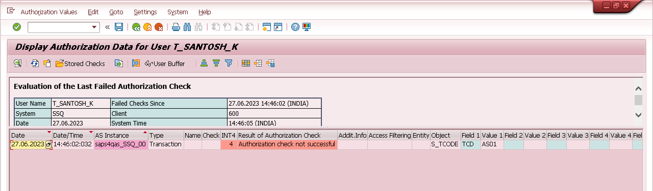
Prerequisites for Creating Purchase Requisition:
Authorization of ME51N for Creation of Purchase Requisition.
Authorization of ME52N for Changing a Purchase Requisition.
Authorization of Concerned Plant for which the user needs to create a Purchase Requisition.
User needs to check if the stock is available or not, if the stock is below safety stock level or not or if the stock is available in some other plant under the same Company Group.
Note: If authorization is not available for a particular object, execute T-Code: SU53 and share the screenshot with the SAP Technical Support for providing the authorization for the same.
(Demo Screenshot of SU53 attached below)

Slide 6
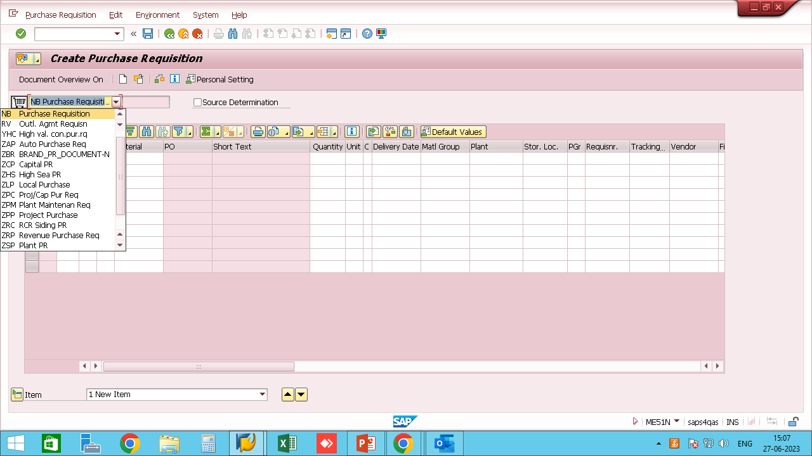
At first the user needs to select the document type for PR.
In Standard SAP there are three types of PR : Framework Req.(FO), Purchase Req.(NB) & Outline Agreement PR(RV).
Note: The same can be customized as per the business requirement through the SAP technical team.

Slide 7
FO Type PR (Framework Requisition)
Framework Requisition is Service based PR (e.g. Freight Charges, Maintenance Charges, Servicing Charges, etc.)
Prerequisites for FO type PR:
Cost Center : Cost center is a part of the organization to which costs may be charged for accounting purposes. The user needs to enter the cost center to which the cost is to be charged.
Material Group for Services: Material Group is used to categorize materials having the same attributes. The same is defined by the SAP company technical team as per business requirement.
Service Number: Service number or activity number is a number created to define a particular type of service or activity and is created by the SAP technical team as per the business requirement.
G/L Account: General Ledger (G/L) accounts are used to provide a picture of external accounting and accounts and to record all the business transactions in a SAP system. The user needs to know the G/L account number to which the accounting will be done for the PR.

Slide 8
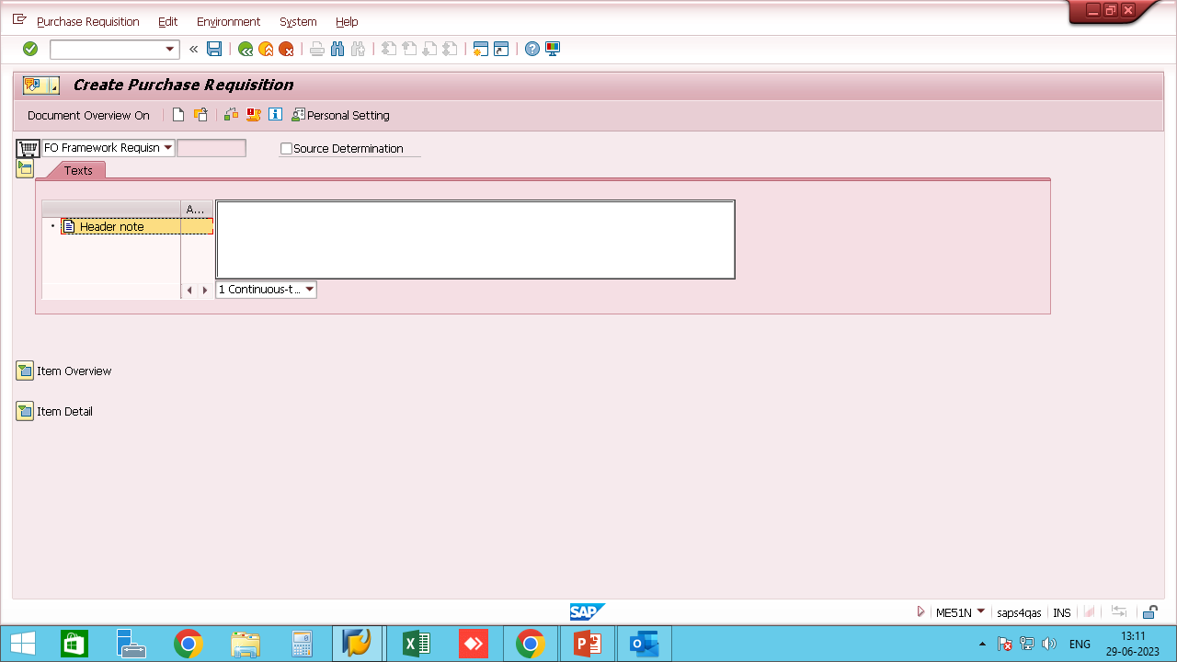
HEADER SCREEN:
Click to expand/
collapse header screen
In the header screen the user needs to enter a header note or text regarding the requisition created, or terms and conditions regarding the purchase requisition.

Slide 9
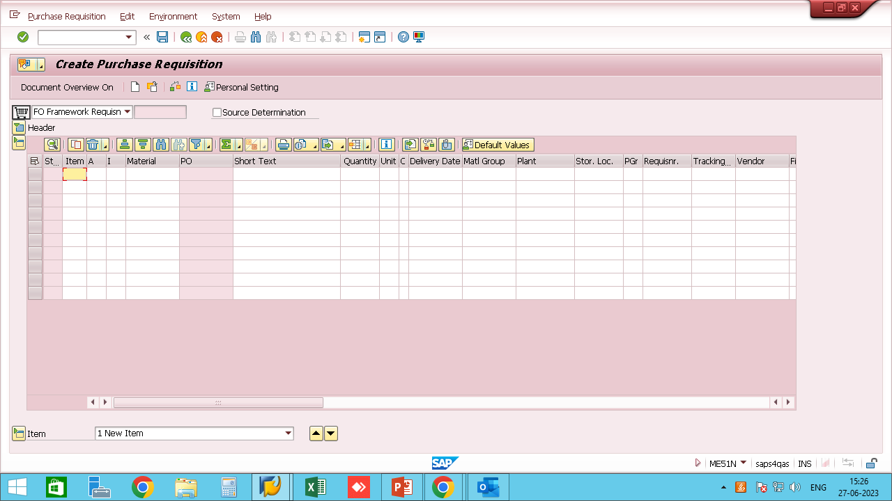
ITEM OVERVIEW SCREEN:
Click to expand/
collapse item overview screen
1
2
3
4
5
6
7
8
9
10
11
12
13

Slide 10
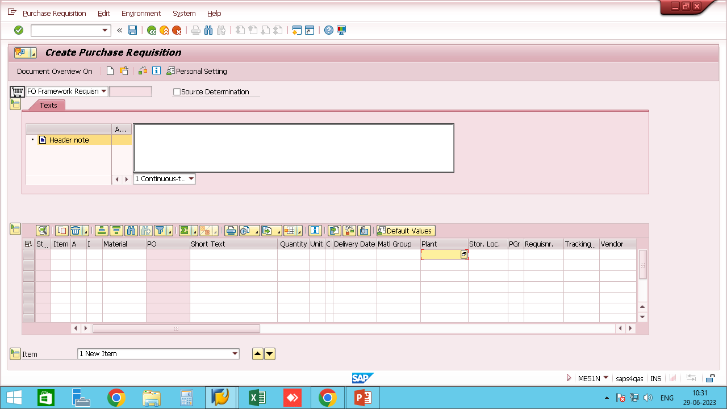
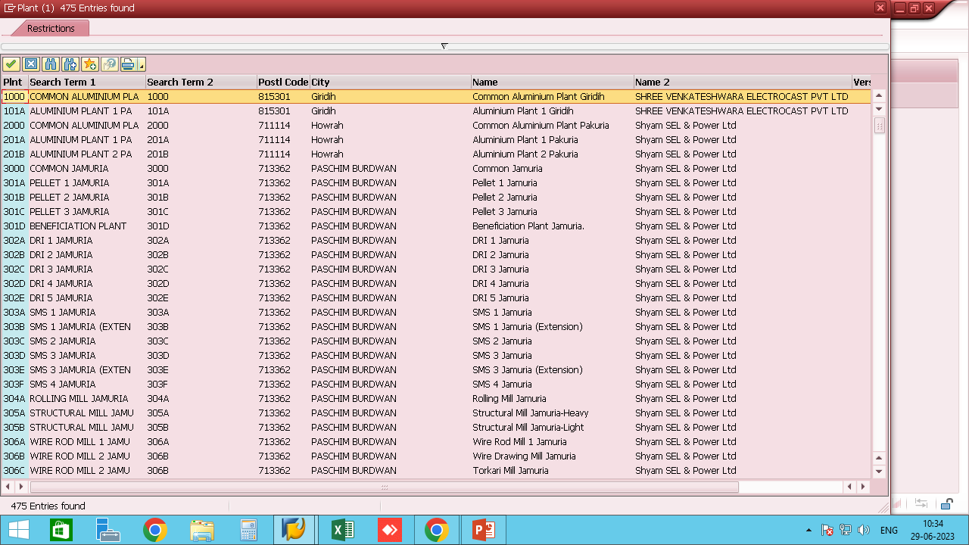
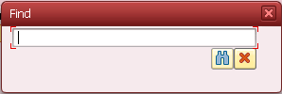
Item No.: Item number need not to be entered by user it is automatically triggered by the system as no. 10, 20, 30, etc.
Account Assignment(A): Account assignment for FO type PR needs to be ‘K’ which is cost center.
Item Category(I): Item Category for FO type PR needs to be ‘D’ which is Service.
Material: No Material need to be entered by the user for FO type PR.
Short Text: The user needs to enter the type of service for which the PR is being created.
Quantity: For FO type PR user does not need to enter the quantity in item overview tab.
Unit of Measure: For FO type PR user does not need to enter the unit of measurement in item overview tab.
Delivery Date: The date on which the goods are to be delivered or the service is to be performed.
Material Group: The user needs to enter the material group for services as defined by the SAP technical team as per company requirement.
Plant: The user needs to enter the plant code for which the requisition is being prepared. If the plant code is unknown the user can search for the same by pressing F4in plant or the search option as shown below.
In the find dialog box, enter the plant name and select the requisitioner plant.

Slide 11
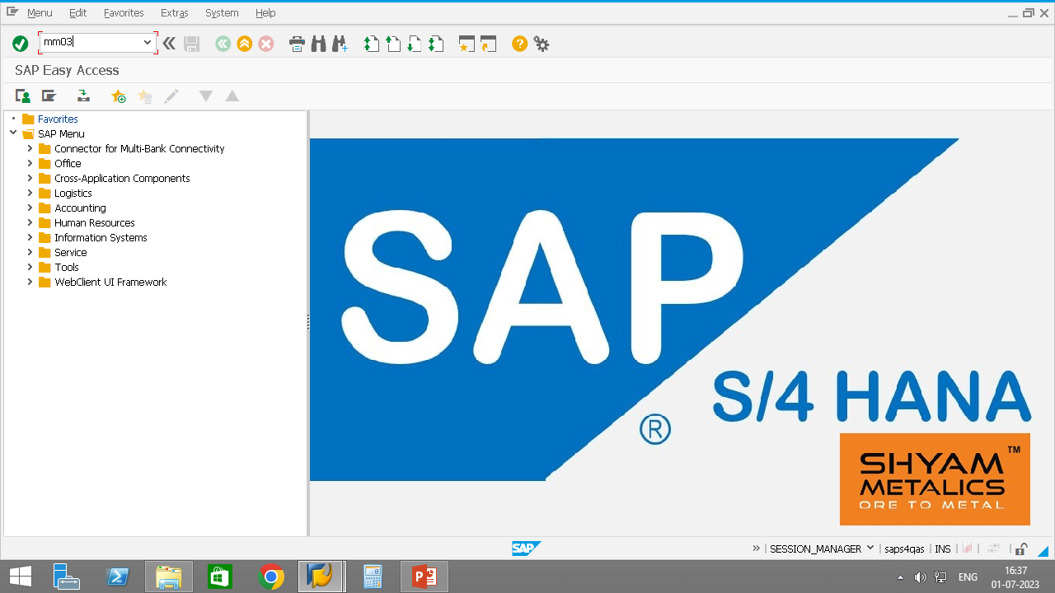
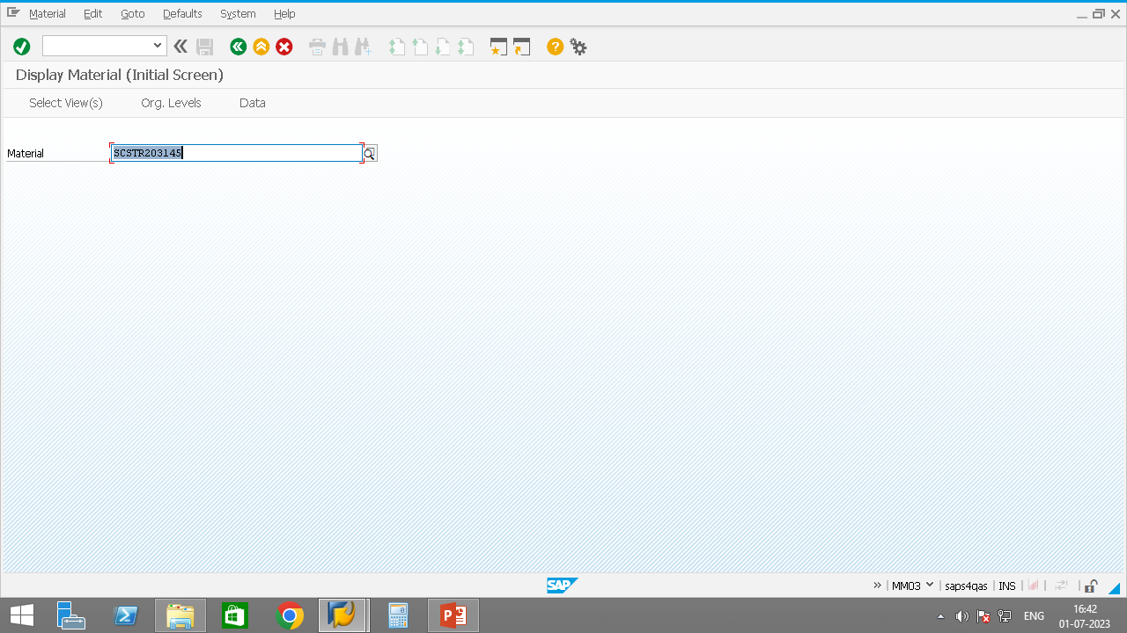
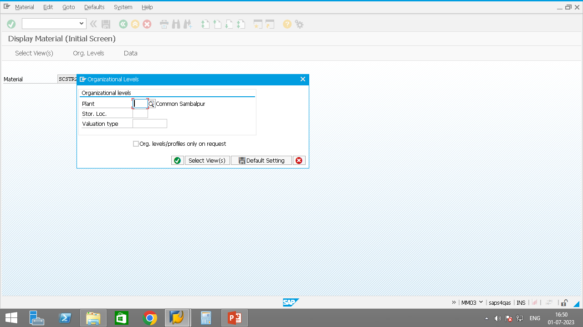
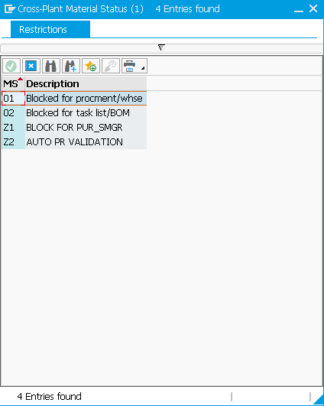
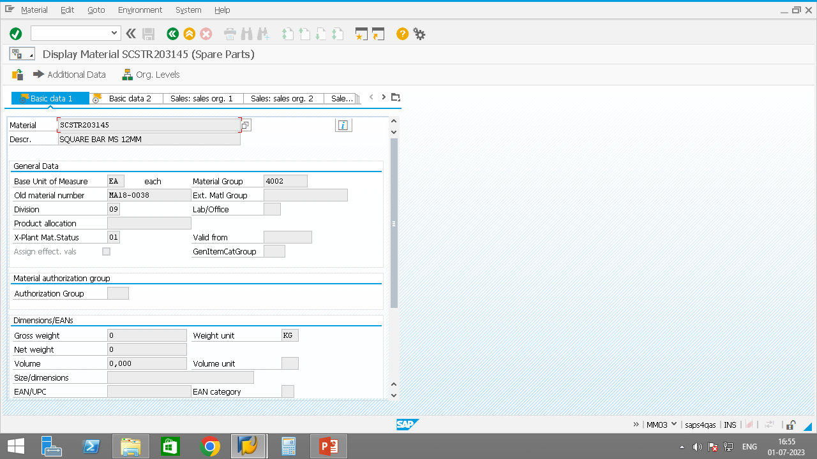
Special Note: If material is blocked for purchasing, then user can check for the same by executing the t-code MM03 and refer to X-Plant material status in basic data 1 tab as shown below
Execute T-Code MM03 and hit enter
Enter material mode and hit enter
Enter plant and storage location and hit enter
In standard SAP only two types of restrictions are there for a material namely, 01(Blocked for procurement) & 02(Blocked for task list/BOM) but other restrictions can be applied as per business requirement.
If a particular material is blocked the user needs to check for another material code, remove the restriction from the material by the SAP technical team or create another material code as per requirement and material specs.
Check for X-Plant Material Status
Types of restriction in material

Slide 12
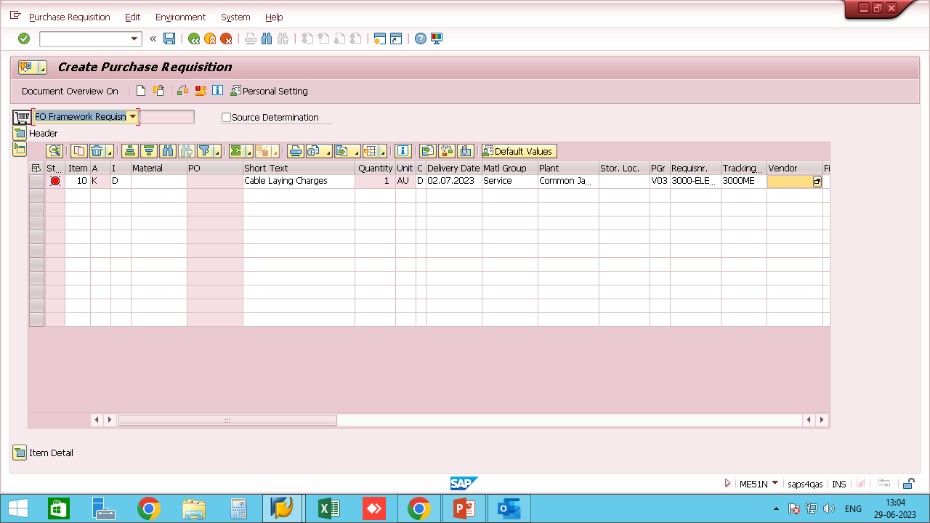
Storage Location: Name of the storage location in which the material is stored. A plant may contain one or more storage locations. For FO type PR the user need not to enter the storage location.
Purchasing Group: Purchasing Group is a key for a buyer or a group of buyers, who is/are responsible for certain purchasing activities. The user needs to enter the purchasing group from which the service is taken and is defined by the SAP technical team as per the company requirement.
Requisitioner & Tracking No. : Requisitioner indicates for whom the material or external service shown in the purchase requisition is to be ordered. Tracking No. is a number that facilitates the monitoring of the procurement of required materials or services. Both the fields are normal text fields in standard SAP but the same can be customised as per the business requirement.
Vendor: Desired Vendor specifies the number/code of the vendor(as created in master data) suggested by the requisitioner to the purchasing department for this purchase order. It is not mandatory for the user to enter vendor code in FO type PR.
Snapshot of Item overview tab with the data filled in is shown on the right:

Slide 13
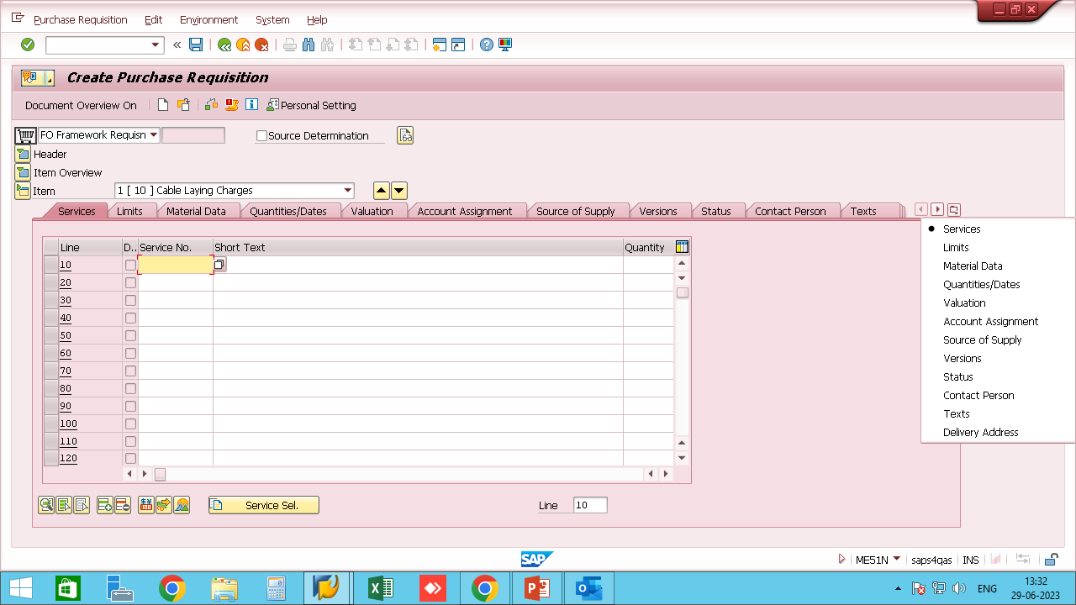
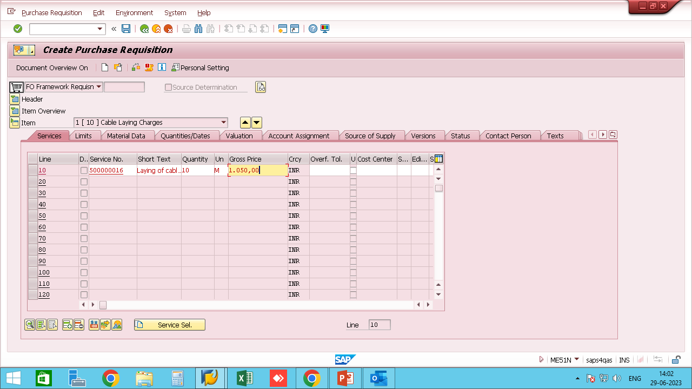
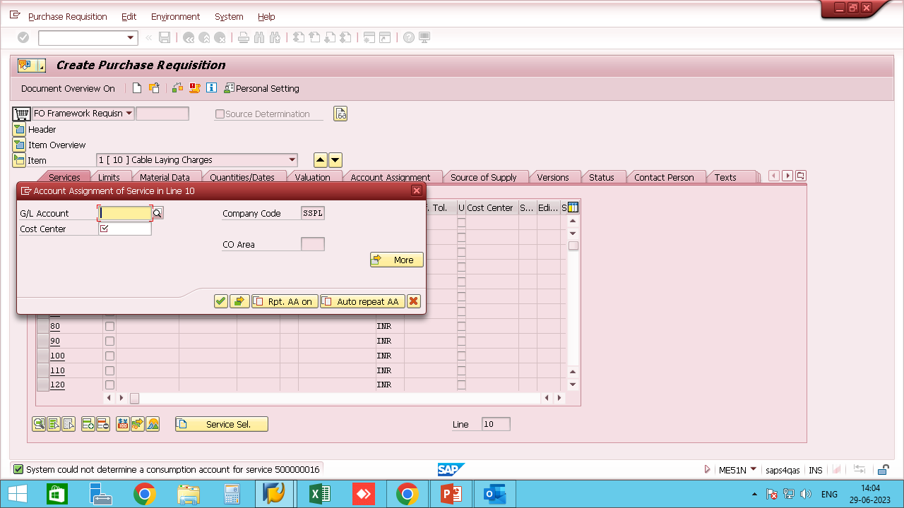
ITEM DETAILS SCREEN:
Click to see all the tabs in item details screen as shown below
Click to expand/
collapse item details screen
1
2
Services: In the services tab the user needs to enter the Service/Activity number, Quantity and Unit of Measurement and hit enter. The system will then ask for G/L account number and cost center. See snapshot for reference..
After hitting enter the system will ask for G/L account and cost center.

Slide 14
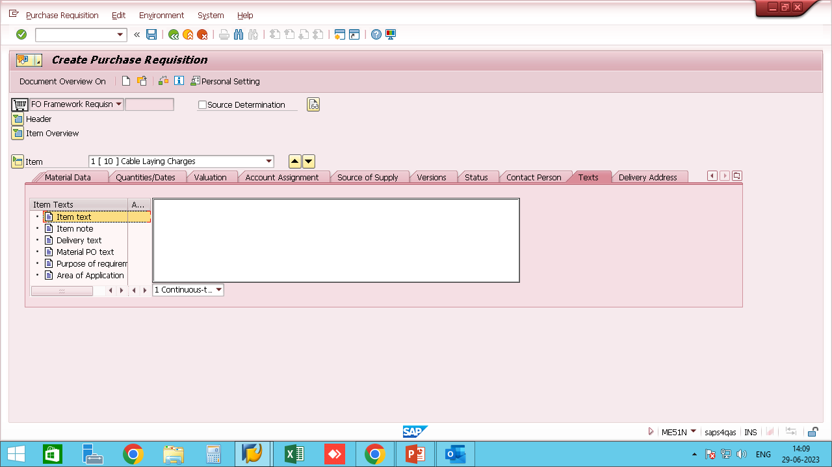
2. Texts: In Material PO text SAP will draw the material specifications from Material master, the user can check if the material specs are matching the user requirements. If those specifications don’t match the user requirements the user needs to search for another material code or create one as per requirement.

Slide 15
RV Type PR (Outline Agreement Requisition)
Outline Agreement PR is used for service or consignment purchase where we don’t know the fix delivery date and we want to create a requisition against the same. Unlike other document types FO and NB which require a delivery date, RV document type does not require one.
Prerequisites for RV type PR:
Material Group : Material Group is used to categorize materials having the same attributes. The same is defined by the SAP company technical team as per business requirement.
Asset Number: If requisition is raised for an asset then the user needs to know the asset number assigned in SAP towards the particular asset(Asset number can be searched in AS03).
WBS Element: If requisition is raised for a project consignment the user needs to know the Work Bench Structure Element assigned against the material in SAP(WBS Element can be created and searched in CJ20N).
Network Number: If requisition is raised for a service particularly for a project the user needs to know the network number assigned to the service against the project in SAP(Networ

